Slide 1
Tomasz Kielar
Jarosław Stadnicki jaroslawstadnicki.pl

Slide 2
Micro services
Everything you wanted to know, but were too lazy to check out

Slide 3
Why
What we wanted to check out
What are micro services all about
Stuff we’ve done
Problems we’ve faced
Stuff we’ve learnt

Slide 4
  Why

Slide 5

Why
  Pure stupid curiosity

Slide 6
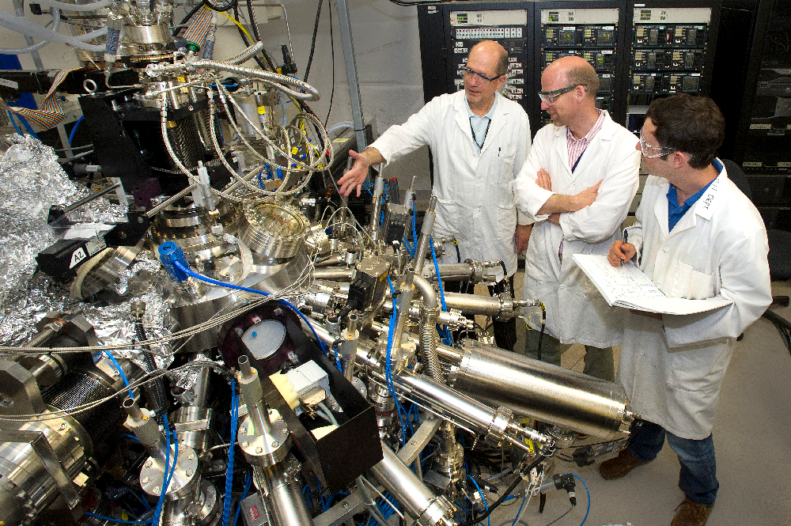
Why
  Well, that shouldn’t be that hard

Slide 7
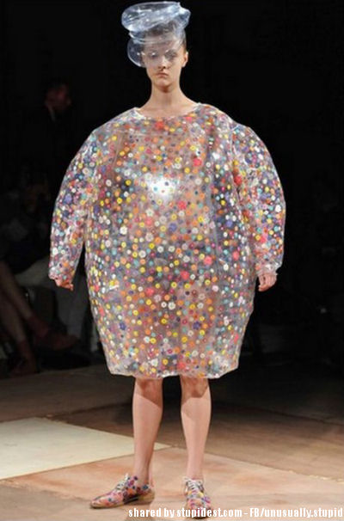
Why
  That’s the trend

Slide 8

Why
  Everyone’s done it already

Slide 9

Why
  We've got grant from our boss

Slide 10
  What we wanted to check out

Slide 11
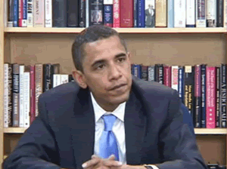
What we wanted to check out
  How to start

Slide 12
What we wanted to check out
  Versioning

Slide 13

What we wanted to check out
  Mythical scaling

Slide 14

What we wanted to check out
  What to do when service is down

Slide 15

What we wanted to check out
  How to find a service

Slide 16

  What are microservices all about

Slide 17
What are microservices all about
  (…) the microservice architectural style is an approach to developing a single application as a suite of small services, each running in its own process and communicating with lightweight mechanisms (…)
  - martin fowler

Slide 18
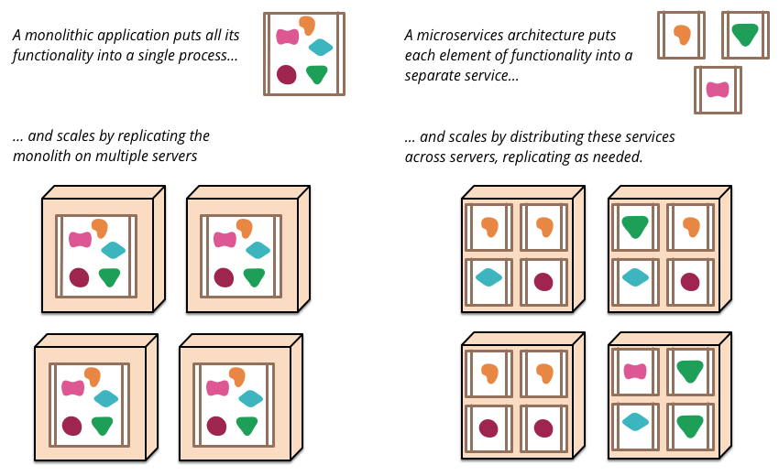
What are microservices all about
http://martinfowler.com/articles/microservices.html

Slide 19
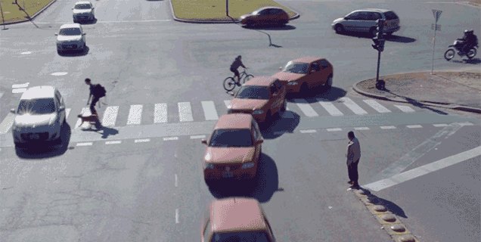
What are microservices all about
  Decentralized Governance

Slide 20

What are microservices all about
  Design for failure

Slide 21

What are microservices all about
  Evolutionary Design

Slide 22

  Stuff we’ve done

Slide 23
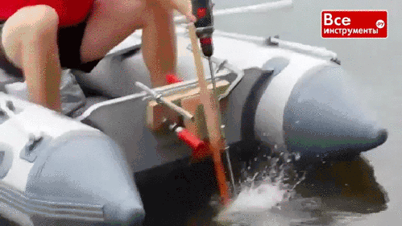
Stuff we’ve done
  It works (mostly)

Slide 24
Stuff we’ve done
  We have scaling, but without a slider

Slide 25
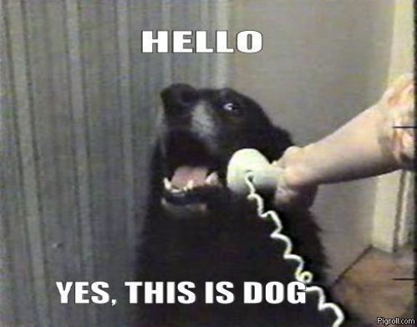
Stuff we’ve done
  Services register automatically

Slide 26
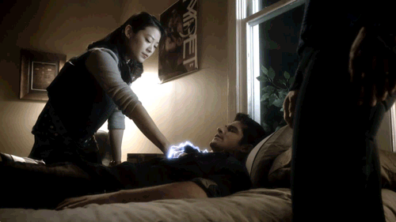
Stuff we’ve done
  Services can die and can be restored

Slide 27

  Problems we’ve faced

Slide 28
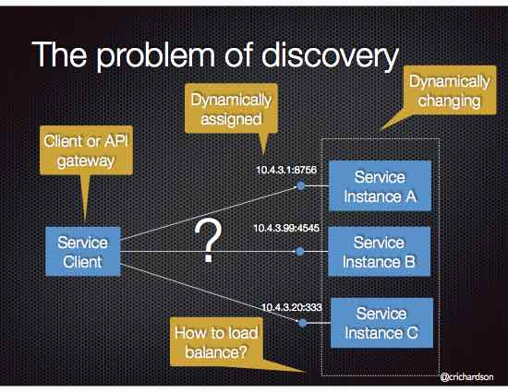
What are microservices all about

Slide 29
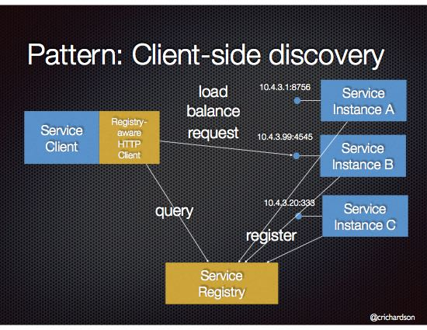
What are microservices all about

Slide 30
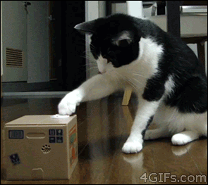
Problems we faced
  New ASP.NET

Slide 31
Problems we faced
  Managing lifecycle of services

Slide 32
Problems we faced
  Dependencies between services

Slide 33

Problems we faced
  Configuration management

Slide 34

  Stuff we’ve learnt

Slide 35
Stuff we’ve learnt
  Use frameworks!
  Consul
  Zookeeper
  Eureka
  etcd

Slide 36
Stuff we’ve learnt
  Automatic deploy
Notes:
Continuous delivery
Automatyczne testy
Deploy na produkcje
Manualne testy na produkcji

Slide 37
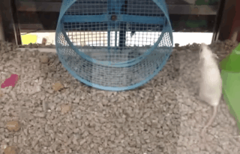
Stuff we’ve learnt
  Don’t try to reinvent the wheel

Slide 38
Stuff we’ve learnt
  Frameworks do a lot for you. Sometimes you don’t even know that you have to have something

Slide 39
Stuff we’ve learnt
  Reusable code!

Slide 40

Stuff we’ve learnt
  Log!

Slide 41
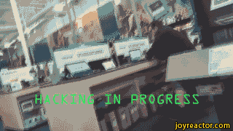
Demo
Demo, party hard, crash bytes!

Slide 42
Stuff we’ve learnt
  Micro services are not the silver bullet

Slide 43
Questions?

Slide 44
Feedback: jaroslaw.stadnicki@gmail.com https://bitbucket.org/jstadnicki/calculator-uservice

Slide 45
Thank you

Slide 46
PGS Software S.A.
Tel.: +48 71 79 82 692
Fax: +48 71 79 82 690
E-mail: pgs-soft@pgs-soft.com
www.pgs-soft.com

