Slide 1
Whats new in C#

Slide 2
About me:
Jarosław Stadnicki
jaroslaw.stadnicki@gmail.com
@j_stadnicki
jstadnicki.blogspot.com

Slide 3
Sounds like a plan
Null Conditional Operator
Name Of Expressions
Primary Constructor
Expression Bodied Functions And Properties
Static Using Syntax
Autoproperty Initializers
Dictionary Initializers
String Interpolation
Exception Filters
Async Catch

Slide 4
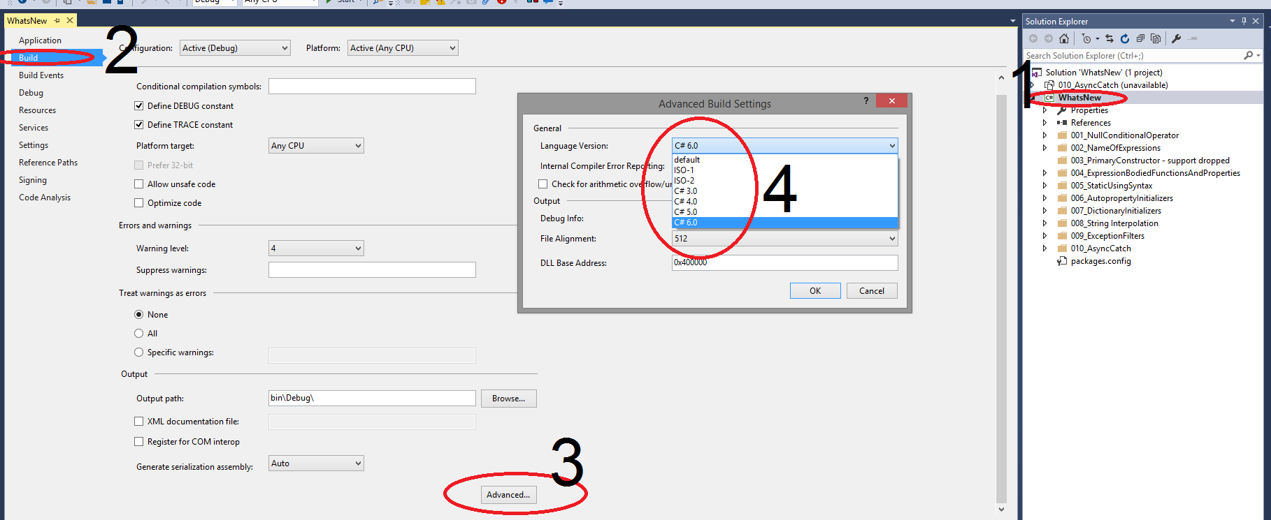
Enabling C# 6

Slide 5
Null Conditional Operator
public string TrimChildTextWithIf(Node item)
{
if (item == null)
{
return string.Empty;
}
if (item.Child == null)
{
return string.Empty;
}
if (string.IsNullOrEmpty(item.Child.Text))
{
return string.Empty;
}
return item.Child.Text.Trim();
}
public string TrimChildTextWith6(Node item)
{
return item?.Child?.Text?.Trim() ??
string.Empty;
}

Slide 6
Name Of Expressions
public static string ParameterName(object o)
{
return "inputParameter";
}
public static string ClassName()
{
return "NameOfExpression";
}
[NameOfExpressionDemo]
public static string AttributeName()
{
return "NameOfExpressionDemoAttribute";
}
public static string ParameterName(
string inputParameter)
{
return nameof(inputParameter);
}
public class NameOfExpression {
public static string ClassName()
{
return nameof(NameOfExpression);
}
}
[NameOfExpressionDemo]
public static string AttributeName()
{
return
nameof(NameOfExpressionDemoAttribute);
}

Slide 7
Primary Constructor
Not supported

Slide 8
Expression Bodied Functions And Properties
public class ExpressionBodyNew
{
private string _somePropertyValue;
public string SomePropertyValue => _somePropertyValue;
public ExpressionBodyNew(string input)
{
_somePropertyValue = input;
}
public string SomeSimpleMethod() => string.Format("{0}x{0}", SomePropertyValue, SomePropertyValue);
}
public class ExpressionBodyOld
{
public ExpressionBodyOld(string input)
{
SomePropertyValue = input;
}
public string SomePropertyValue { get; private set; }
public string SomeSimpleMethod()
{
return string.Format("{0}x{1}", SomePropertyValue, SomePropertyValue);
}
}

Slide 9
Static Using Syntax
[TestFixture]
public class OldTestDemo
{
[Test]
public void T001_OldWayOfCalling()
{
Assert.AreEqual("Ala ma kota",
DemoClass.ReturnSomeText());
}
}
using static DemoClass;
[TestFixture]
public class NewTestDemo
{
[Test]
public void T001_NewWayOfCalling()
{
Assert.AreEqual("Ala ma kota",
ReturnSomeText());
}
}

Slide 10
Autoproperty Initializers
public class AutoInitializePropertyClassOldWay
{
public AutoInitializePropertyClassOldWay()
{
PropertyValue = "hello si sharp";
}
public string PropertyValue { get; set; }
}
public class AutoInitializePropertyClassNewWay
{
public string PropertyValue
{ get; set; } = "hello si sharp";
}

Slide 11
Dictionary Initializers
public OldDictionaryClass()
{
dictionary = new Dictionary<string, string>
{
{"Hello","World" },
{"Si","Sharp" }
};
}
public NewDictionaryClass()
{
dictionary = new Dictionary<string, string>
{
["Hello"] = "World",
["Si"] = "Sharp"
};
}

Slide 12
String Interpolation
public string OldFormatText
(double price, DateTime date)
{
return
string.Format("{0:d} {1:C}", date, price);
}
public string NewFormatText
(double price, DateTime date)
{
return $"{date:d} {price:C}";
}

Slide 13
Exception Filters
try
{
throw new Exception("500");
}
catch (Exception e)
{
if (e.Message == s)
{
return "handled";
}
if (string.IsNullOrEmpty(e.Message))
{
return string.Empty;
}
throw;
}
try
{
throw new Exception("500");
}
catch (Exception e) when
(e.Message == s)
{
return "handled";
}
catch (Exception e) when
(string.IsNullOrEmpty(e.Message))
{
return string.Empty;
}
catch (Exception)
{
throw;
}

Slide 14
Async Catch
Error CS1985
Cannot await in a catch clause
Error CS1984
Cannot await in the body of a finally clause
try
{
await TestClass.ThrowsAsync();
}
catch (Exception)
{
await TestClass.CatchAsync();
}
finally
{
await TestClass.FinallyAsync();
}

Slide 15

The Road to C# 7 Has Begun

Slide 16
Questions

Slide 17
Thank you.
Please give feedback jaroslaw.stadnicki@gmail.com

